Slide 1
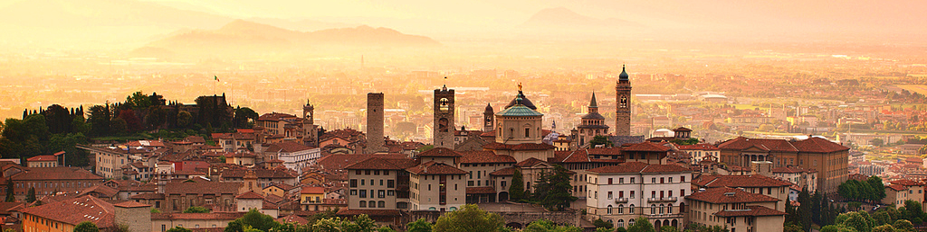
10th Joint Meeting of the European Software Engineering Conference and the ACM SIGSOFT Symposium on the Foundations of Software Engineering: FSE’15
GALE: Geometric active learning for Search-Based Software Engineering
Joseph Krall, LoadIQ
Tim Menzies, NC State
Misty Davies, NASA Ames
Sept 5, 2015

Slide 2
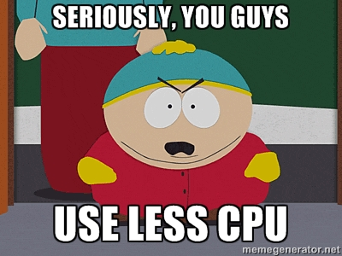

Slide 3
This talk
Why use less CPU for search-based SE?
How to use less CPU
GALE’s “geometric search”
Experimental results
Related work
Future work
A challenge question:
Are we making this too hard?

Slide 4
This talk
Why use less CPU for search-based SE?
How to use less CPU
GALE’s “geometric search”
Experimental results
Related work
Future work
A challenge question:
Are we making this too hard?

Slide 5
This talk
Why use less CPU for search-based SE?
How to use less CPU
GALE’s “geometric search”
Experimental results
Related Work
Future work
A challenge question:
Are we making this too hard?

Slide 6
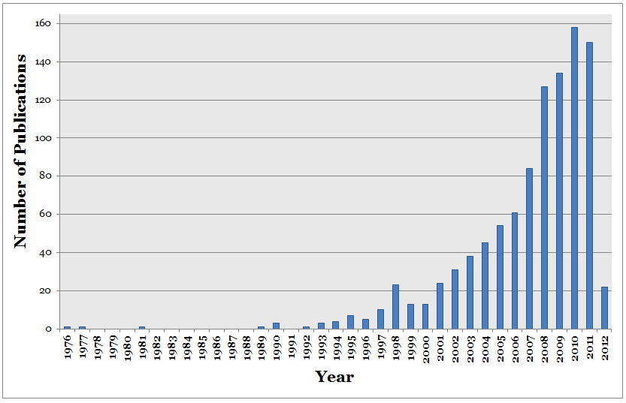
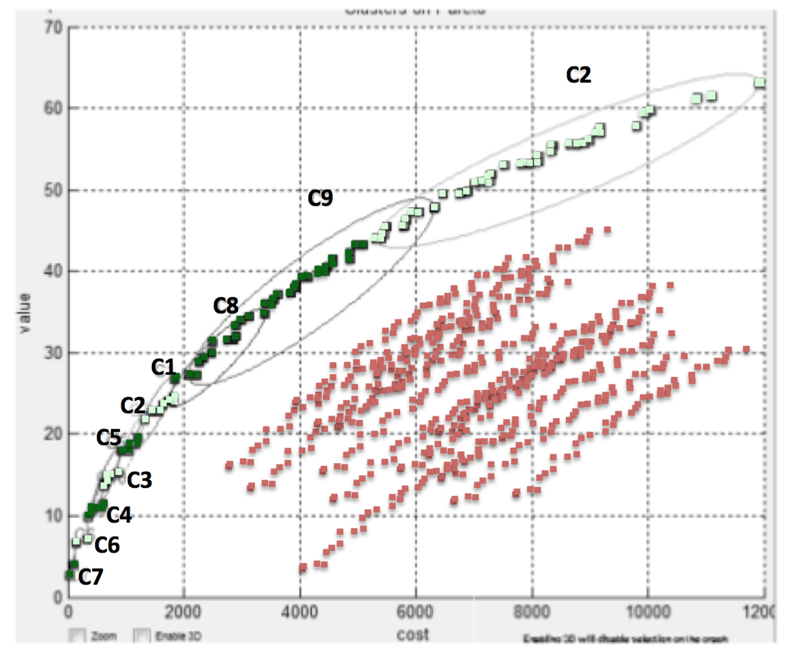
SBSE = CPU-intensive
Explosive growth of SBSE papers
Evaluates 1000s, 1,000,000s of candidates
Objectives = evaluate(decisions)
Cost = Generations * Selection + Evaluation * Generation
G * O(N²) + K * O(1) * N

Slide 7
SBSE = everything
1. Requirements Menzies, Feather, Bagnall, Mansouri, Zhang
2. Transformation Cooper, Ryan, Schielke, Subramanian, Fatiregun, Williams
3.Effort prediction Aguilar-Ruiz, Burgess, Dolado, Lefley, Shepperd
4. Management Alba, Antoniol, Chicano, Di Pentam Greer, Ruhe
5. Heap allocation Cohen, Kooi, Srisa-an
6. Regression test Li, Yoo, Elbaum, Rothermel, Walcott, Soffa, Kampfhamer
7. SOA Canfora, Di Penta, Esposito, Villani
8. Refactoring Antoniol, Briand, Cinneide, O’Keeffe, Merlo, Seng, Tratt
9. Test Generation Alba, Binkley, Bottaci, Briand, Chicano, Clark, Cohen, Gutjahr, Harrold, Holcombe, Jones, Korel, Pargass, Reformat, Roper, McMinn, Michael, Sthamer, Tracy, Tonella,Xanthakis, Xiao, Wegener, Wilkins
10. Maintenance Antoniol, Lutz, Di Penta, Madhavi, Mancoridis, Mitchell, Swift
11. Model checking Alba, Chicano, Godefroid
12. Probing Cohen, Elbaum
13. UIOs Derderian, Guo, Hierons
14. Comprehension Gold, Li, Mahdavi
15. Protocols Alba, Clark, Jacob, Troya
16. Component sel Baker, Skaliotis, Steinhofel, Yoo
17. Agent Oriented Haas, Peysakhov, Sinclair, Shami, Mancoridis

Slide 9
Many reasons to use less CPU
Less power consumption
less power generation = less pollution
Less cost
of hardware
of cloud time

Slide 10
More CPU is more confusing: who understands all that output?
Ever tried to explain to a Pareto frontier to a business user?
Ever been asked for an audit trial on how conclusions were made?
Verrappa and Letier:
“..for industrial problems, these algorithms generate (many) solutions, which makes the tasks of under- standing them and selecting one among them difficult and time consuming”
https://goo.gl/LvsQdn
Evaluates 1000s, 1,000,000s of candidates

Slide 11
This talk
Why use less CPU for search-based SE?
How to use less CPU
GALE’s “geometric search”
Experimental results
Related work
Future work
A challenge question:
Are we making this too hard?

Slide 12
How to use less CPU (for SBSE)

Slide 13
How to use less CPU (for SBSE)

Slide 14
How to use less CPU (for SBSE)
Objectives = evaluate(decisions)
Generations * Selection + Evaluation * Generation
G * O(N²) + K* O(1)*N

Slide 15
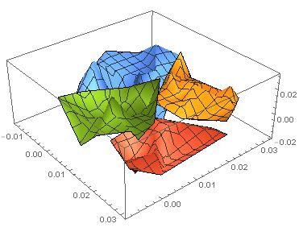
How to use less CPU (for SBSE)
Objectives = evaluate(decisions)
Generations * Selection + Evaluation * Generation
G * O(N²) + K * O(1)*N
Approximate the space
Near linear time k=2 divisive clustering
Evaluate 2 distant points (X,Y) per cluster
If better(X,Y)
If size(cluster) > large
Split, recurse on better half
Else, push points towards X

Slide 16
How to use less CPU (for SBSE)
Objectives = evaluate(decisions)
Generations * Selection + Evaluation * Generation
G * O(N²) + K * O(1)*N
Approximate the space
Near linear time k=2 divisive clustering
Evaluate 2 distant points (X,Y) per cluster
If better(X,Y)
If size(cluster) > large
Split, recurse on better half
Else, push points towards X
e.g. orange points get pushed this way
Red is culled

Slide 17
How to use less CPU (for SBSE)
Objectives = evaluate(decisions)
Generations * Selection + Evaluation * Generation
G * O(N²) + K * O(1)*N
Approximate the space
Near linear time k=2 divisive clustering
Evaluate 2 distant points (X,Y) per cluster
If better(X,Y)
If size(cluster) > large
Split, recurse on better half
Else, push points towards X
g * O(N) + log( K * O(1) * N)
e.g. orange points get pushed this way
Red is culled

Slide 18
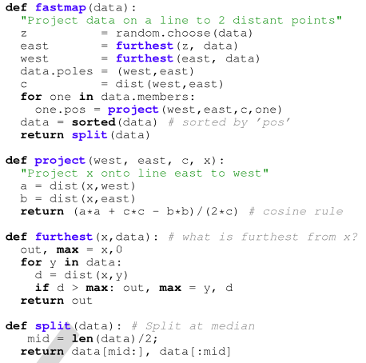
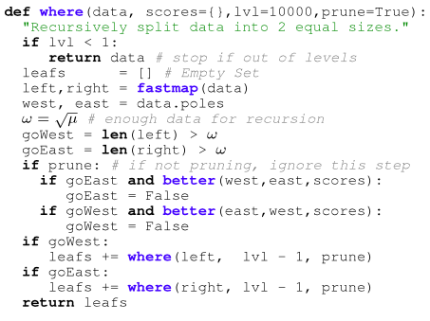
Fast k=2
Divisive
clustering

Slide 19
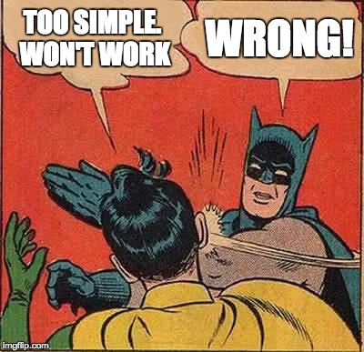

Slide 20
This talk
Why use less CPU for search-based SE?
How to use less CPU
GALE’s “geometric search”
Experimental results
Related work
Future work
A challenge question:
Are we making this too hard?

Slide 21
Sample models
Benchmark suites (small)
SE models
The usual suspects: goo.gl/FTyhkJ
2-3 line equations
Fonseca, Schaffer, woBar. Golinski,
Also, from goo.gl/w98wxu
The ZDT suite :
The DTLZ suite
On-line at: goo.gl/nv2AVK
XOMO: goo.gl/tY4nLu COCOMO software effort estimator + defect prediction + risk advisor
POM3: goo.gl/RMxWC Agile teams prioritizing tasks
Tasks costs and utility may subsequently change
Teams depend on products from other teams
Internal NASA models:
CDA: goo.gl/wLVrYA
NASA’s requirements models for human avionics

Slide 22
Comparison algorithms
What we used (in paper)
Since paper
NSGA-II (of course)
SPEA2
Selected from Sayyad et al’s ICSE’13 survey of “usually used MOEAs in SE”
Not IBEA:
BTW, I don’t like IBEA, just its continuous domination function
Used in GALE
Differential evolution
MOEA/D
?NSGA III
Some quirky “bunching problems”

Slide 23
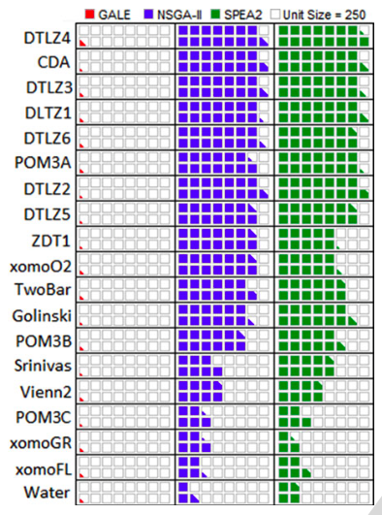
Evaluations per generation: GALE = O(log(N)); Others = O(N)

Slide 24
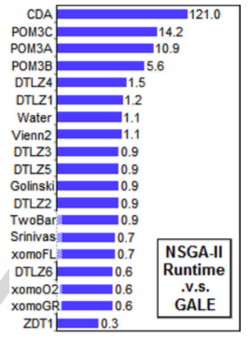
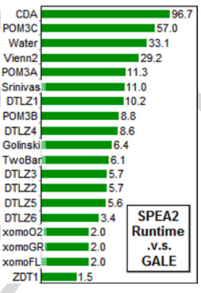
For small models, not much slower For big models, 100 times faster

Slide 25
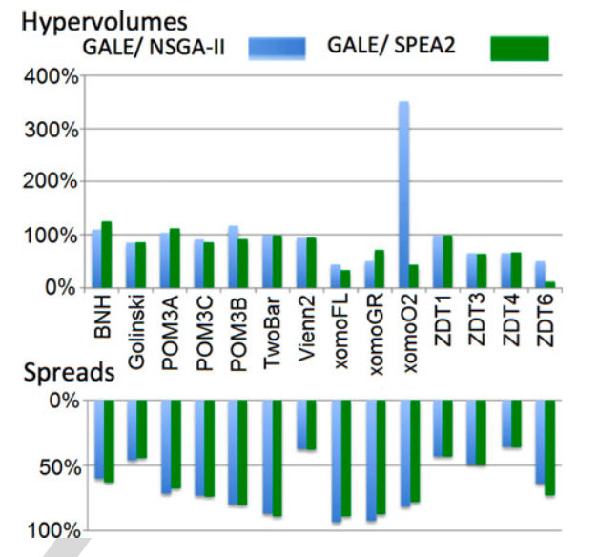
Other Performance Measures
Hypervolume:
• Volume sweeped out by the Pareto frontier
• More is best
• GALE’s random search explores less than others
Spread:
• gap between final solutions
• less is best • GALE’s gaps are less: it explores its space in more details

Slide 26
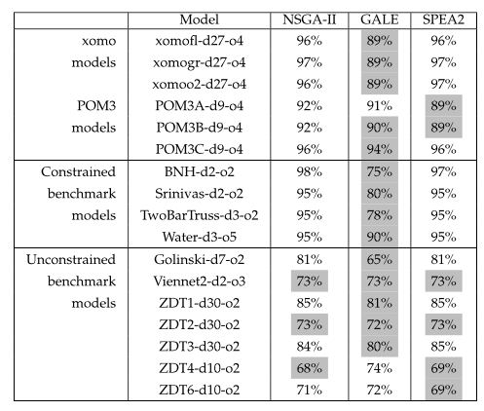
Statistical comparisons improvements pop0 to last pop
Gray:
GALE
is as good
as the
best

Slide 27
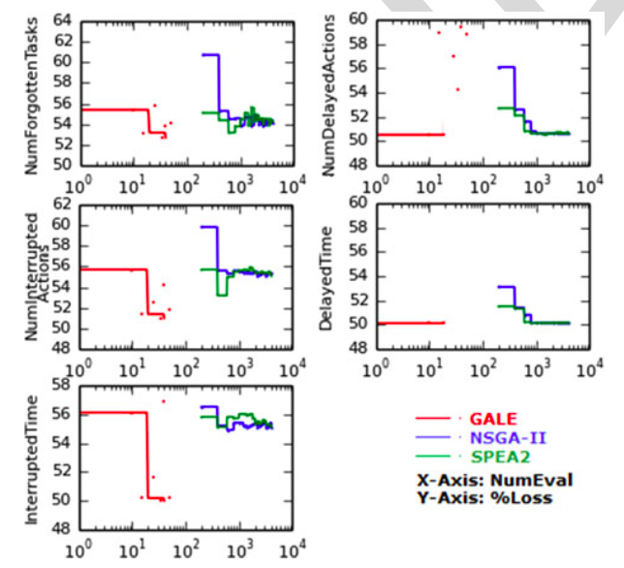
One big models, GALE does very well
NASA’s requirements models for human avionics
• GALE: 4 mins
• NSGA-II: 8 hours

Slide 28
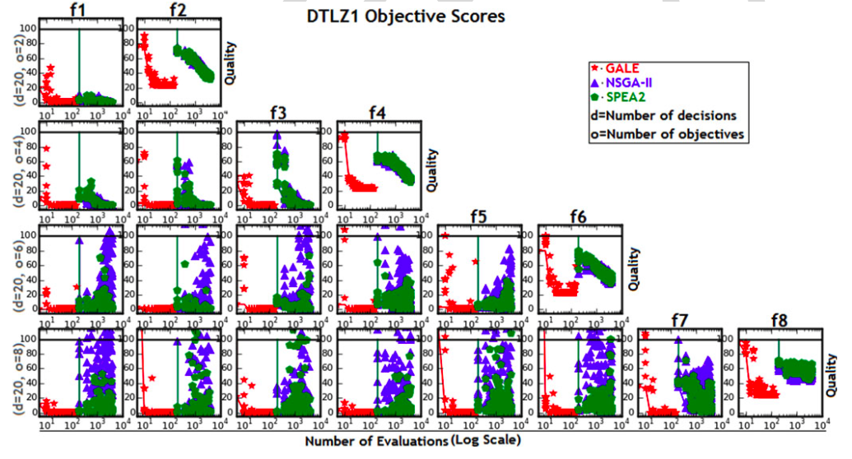
DTLZ1:from 2 to 8 goals

Slide 29
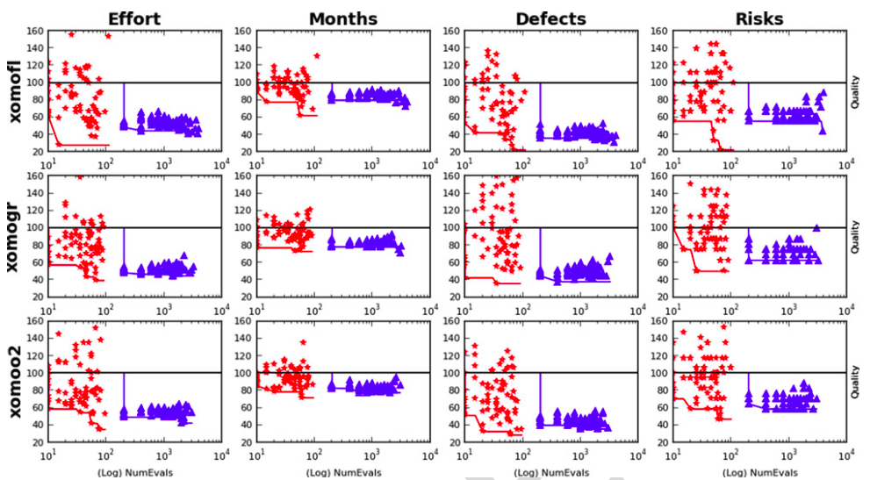
XOMO: estimates of effort, months, defects, risks (on NASA projects)
Flight
systems
Ground
systems
Flight
Guidance
systems
GALE
NSGA-II

Slide 30
This talk
Why use less CPU for search-based SE?
How to use less CPU
GALE’s “geometric search”
Experimental results
Related Work
Future work
A challenge question:
Are we making this too hard?

Slide 31
Related work
MOEA/D: Zhang [15]
Population0
assignment of random objective weights
clustering of candidates with different directions
Afterwards: spreads in all directions
SPEA2, NSGA-II, PSO, DE, MOEA/D, Tabu..
All O(N) evaluations
Various local search methods (Peng [40])
None known in SE
None boasting GALE’s reduced runtimes
Response surface methods Zuluaga [8]
Parametric assumptions about Pareto frontier
Active learning

Slide 32
This talk
Why use less CPU for search-based SE?
How to use less CPU
GALE’s “geometric search”
Experimental results
Related Work
Future work
A challenge question:
Are we making this too hard?

Slide 33
Future work
More Models
More Tool Building
Siegmund & Apel’s runtime configuration models
Rungta’s NASA models of space pilots flying MARS missions
100s of Horkoff’s softgoal models
Software product lines
Explanation systems
Complex MOEA tasks solved by reflecting on only a few dozen examples
Human in the loop guidance for the inference?
There remains one loophole GALE did not exploit
So after GALE comes STORM,
Work in progress

Slide 34
This talk
Why use less CPU for search-based SE?
How to use less CPU
GALE’s “geometric search”
uses “active learning”
Experimental results
Related Work
Future work
A challenge question:
Are we making this too hard?

Slide 35
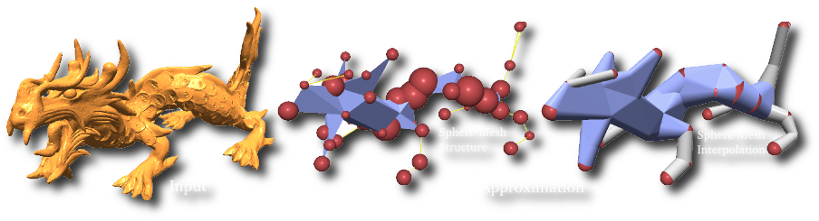
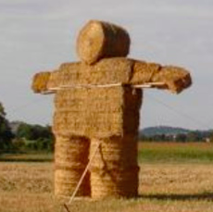
GALE’s dangerous idea
Simple approximations exist for seemingly complex problems.
Researchers jump to the complex before exploring the simpler.
Test supposedly sophisticated vs simpler alternates (the straw man ).
My career: “my straw men don’t burn”

Slide 36
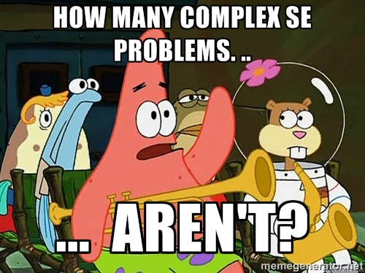

Slide 37
Linear-time recursive descent clustering
e.g. 398 cars
Maximize acceleration,
Maximize mpg

Slide 38
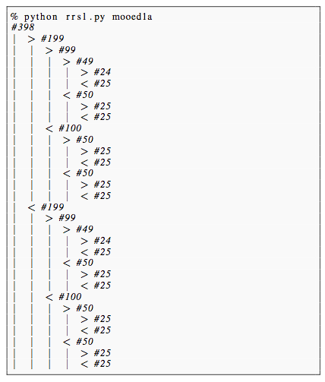
Linear-time recursive descent clustering
e.g. 398 cars
Maximize acceleration,
Maximize mpg

Slide 39
Linear-time recursive descent clustering
e.g. 398 cars
Maximize acceleration,
Maximize mpg
Find splits using FASTMAP [Faloutsos & Lin ’95]
W= anything
X= most distant to W
Y= most distant to X
O(2N)
At each level only check for dominance of XY
Leaves = non-dominated examples (i.e. the Pareto frontier)

Slide 40
Linear-time recursive descent clustering
e.g. 398 cars
Maximize acceleration,
Maximize mpg
Find splits using FASTMAP [Faloutsos & Lin ’95]
W= anything
X= most distant to W
Y= most distant to X
O(2N)
At each level only check for dominance of XY
Leaves = non-dominated examples (i.e. the Pareto frontier)

Slide 41
Linear-time recursive descent clustering
e.g. 398 cars
Maximize acceleration,
Maximize mpg
Find splits using FASTMAP [Faloutsos & Lin ’95]
W= anything
X= most distant to W
Y= most distant to X
O(2N)
At each level only check for dominance of XY
Leaves = non-dominated examples (i.e. the Pareto frontier)

Slide 42
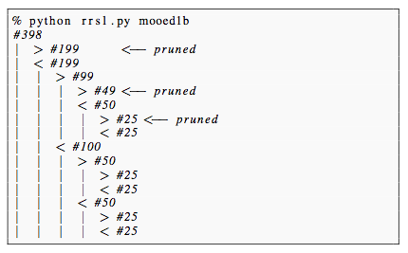
Linear-time recursive descent clustering
e.g. 398 cars
Maximize acceleration,
Maximize mpg
Find splits using FASTMAP [Faloutsos & Lin ’95]
W= anything
X= most distant to W
Y= most distant to X
O(2N)
At each level only check for dominance of XY
Leaves = non-dominated examples (i.e. the Pareto frontier)
14 evaluations
of goals

Slide 43
Linear-time recursive descent clustering
e.g. 398 cars
Maximize acceleration,
Maximize mpg
Find splits using FASTMAP [Faloutsos & Lin ’95]
W= anything
X= most distant to W
Y= most distant to X
O(2N)
At each level only check for dominance of XY
Leaves = non-dominated examples (i.e. the Pareto frontier)
14 evaluations
of goals

Slide 44
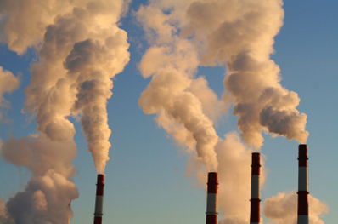
More CPU is more polluting: where do CPUs get their power?
Data centers consume 1.5% of globally electrical output
And growing
2013: 91 billion Kwatt hrs
2020: 139 billion Kwatt hrs
Greenpeace:
(Data centers are…) “perpetuating our addiction to dirty energy technologies of the last two centuries”.
Coal industry boasts:
Big data runs on coal
Forbes magazine:
Cloud begins with coal (and frakking)
[1] http://goo.gl/imKuxp
[2] http://goo.gl/iRpfC7
[3] http://goo.gl/HPKjC

Slide 45

More CPU is More Expensive: cloud facilities heavily monetized
Cloud computation = heavily monetized
Everything costs
Storage
Uploads
Downloads
CPU.

